Slide 1

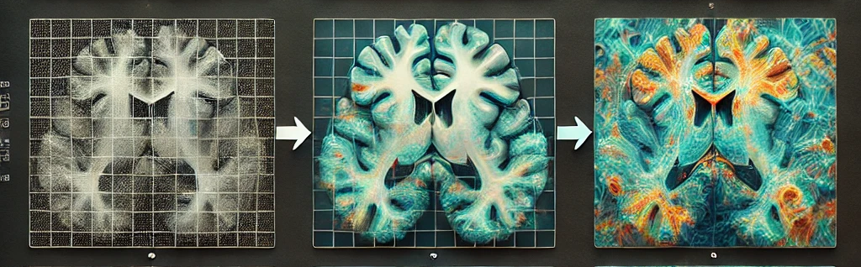
Diffusion Model For Medical Images
Capstone Project Phase B
24-2-R-5
Roi Darom
Hagar Tibi
Supervisors: Dr. Renata Avros & Prof. Zeev Volkovich
Notes:
Hi everyone, my name is Hagar, and this is Roi.
Our Supervisors are Renata and Zeev and Today, we'll be presenting Phase B of our final project, which focus on adapting Camouflaged Object Detection (DiffCOD) model for MRI images.

Slide 2
Purpose of the project
Adaptation of the existing model for Camouflaged object detection to support MRI images
Explore Different approaches between the underlying images and MRI images, such as texture, structure, and context, may impact detection accuracy
Notes:
Let’s begin with the purpose of our project. Our project goal is to adapt the camouflaged object detection model to handle MRI images, building upon its success in detecting camouflaged objects in animal images. While the DiffCOD model has demonstrated its potential in identifying hidden patterns, the transition to MRI images presents challenges that require consideration.
Shifting from animal images to MRI data introduces distinct differences and complexities, including wide variations in image contrast, delicate anatomical details, and the need for specialized preprocessing to address noise and artifacts. Addressing these challenges is crucial to ensuring the model's capability to analyze and interpret the subtle features of MRI images accurately.

Slide 3
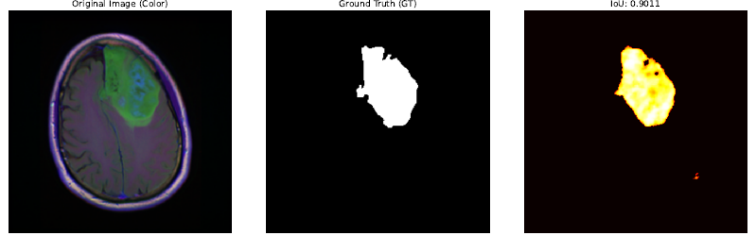
Solution
Incorporating multiple types of noise to enhance the accuracy of tumor detection.
Exploring multiple noise parameters to determine the optimal ones
Notes:
How can we address these challenges?
By incorporating various types of noise to enhance the model's accuracy in tumor detection. Specifically, we experimented with Gaussian Noise and Salt-and-Pepper Noise to improve the model's ability to identify tumors in MRI scans. By feeding the model with these noise types during training, the model became more adept at addressing real-world challenges typically encountered in MRI images, such as blurry visuals, random artifacts caused by the scanning process, and unclear tumor boundaries.
Our findings showed that Gaussian Noise had more significant impact, enhancing the model's ability to detect tumors and more accurately define their boundaries. The detailed results of these experiments will be presented in the upcoming slides.
To achieve these results, several key parameters were considered, as they influence which noise type is most effective for improving tumor detection. These parameters include: Noise Levels, Noise Schedule Shape, Log-Normal Distribution, Sampling Steps and Stochastic Sampling Parameters.

Slide 4
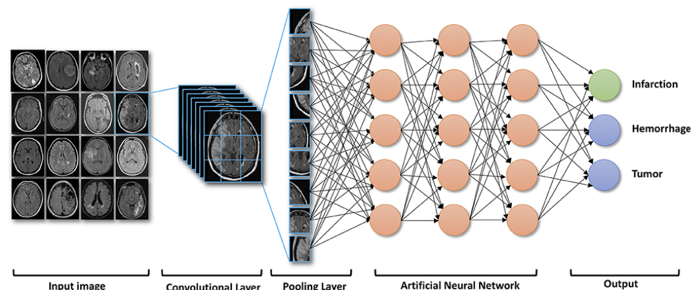
Medical Images Overview
MRI Characteristics:
3D structure, grayscale, and varied modalities.
Challenges:
Class Imbalance: Sparse pathological findings compared to healthy tissue.
Noise and Artifacts
The transition to MRI datasets:
Segmentation: Identifying key regions like abnormalities or tissues.
Preprocessing: Reducing artifacts, and standardizing resolution.
Leveraging spatial relationships for better analysis.
Notes:
To adapt our model for MRI data, it's essential to address the unique characteristics and challenges these images present. Unlike standard images, MRI scans require tailored approaches due to their features. Here’s an overview of MRI Characteristics, Challenges and the transition to MRI datasets:
1. Structure:
MRI scans provide a deepest view of anatomical structures, capturing spatial relationships that regular images cannot. While this enhances analytical capabilities, it also adds complexity to processing and model design.
2. Grayscale Data:
Unlike color images, MRIs can be grayscale, relying on intensity variations to represent body parts or anomalies. This requires the model to focus on subtle differences to identify relevant features.
3. Varied Modalities:
MRI scans come in multiple modalities, each emphasizing different anomaly properties. in our dataset, we focused on FLAIR images, which highlight specific body part characteristics. While this versatility is powerful, it demands modality-specific processing for effective analysis.
Challenges in MRI Datasets
1. Class Imbalance:
MRI datasets often contain sparse pathological findings compared to large amounts of healthy tissue. This imbalance makes detecting anomalies more difficult and necessitates strategies to handle uneven class distributions.
2. Noise and Artifacts:
MRI scans are prone to noise and artifacts caused by scanner variability, patient movement, and other factors. Addressing these requires robust preprocessing techniques to ensure clean and consistent data.
The transition to MRI datasets: 1. Segmentation:
The model focuses on accurately identifying key regions, such as anomalies or tissues, enabling precise detection of tumors and other critical areas.
2. Preprocessing:
By incorporating methods to handle noise, artifacts, and scanner variability, our model mapped the important region.
3. Leveraging spatial relationships :
Leveraging the spatial relationships inherent in the MRI data structure allows the model to gain a deeper understanding of anatomical structures, significantly improving its ability to detect and segment anomalies.
By addressing these features and challenges, our model is tailored to effectively analyze MRI data and deliver accurate, reliable results.

Slide 5
What is Camouflage ?
Camouflage is the phenomenon where an object naturally blends into its environment, making it less noticeable to observers.
Camouflaged object detection is challenging due to the high visual similarity between the object and the background.
The problem is crucial in various fields like military, medical imaging, and wildlife monitoring.
Notes:
Camouflage is the פנומנון where an object naturally blends into its environment, making it less noticeable to the viewer.Detecting camouflaged objects is challenging due to the high similarity between the object and its background, which is אסנישל in various fields such as the military, medical imaging and wildlife monitoring.

Slide 6
Introduction to diffCOD Framework
Diffusion Models: Approach COD (Camouflaged Object Detection) as a denoising process
Training Process: The model learns to recognize objects within noised images using the reverse diffusion process
Key Component: Injection Attention Module (IAM) enhances the denoising capability
Notes:
And now i will do a brief overview about the framework for using diffusion models in the detection of camouflaged objects.The main idea is to treat CODas a denoising process,where the model learns to transform the noise that is added to the image during training.A crucial component of this process is the injection attention module,which significantly improves the model’s ability to denoise.
When I refer to "diffCOD," I am using it as a shorthand for Diffusion Camouflaged Object Detection. Hereafter, I may use either term alternately, but both refer to the same concept.
Gruond truth – רקע שחור , עצם לבן , מיקוד באוביקט הלבן

Slide 7
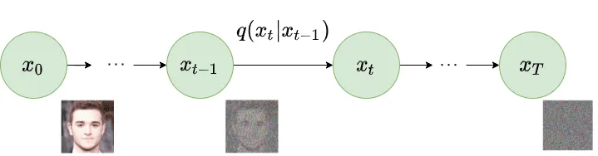
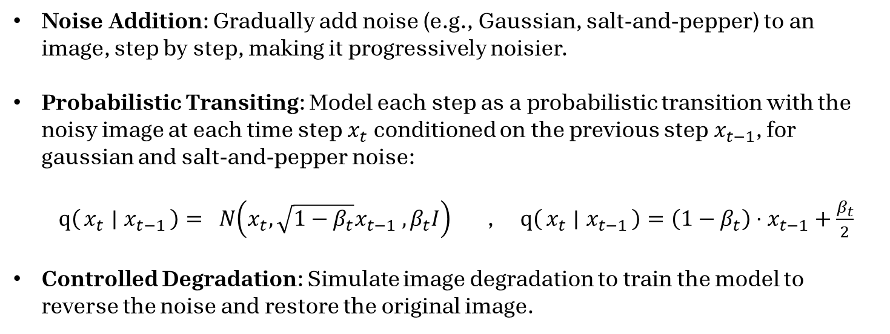
Forward DIFFUSION process
Noise Addition: Gradually add noise (e.g., Gaussian, salt-and-pepper) to an image, step by step, making it progressively noisier.
Probabilistic Transiting: Model each step as a probabilistic transition with the noisy image at each time step$x_{t}$​ conditioned on the previous step$x_{t−1}$​, for gaussian and salt-and-pepper noise: $q\left(x_{t} ∣ x_{t−1}\right)= N\left(x_{t}, \sqrt{1−β_{t}}x_{t−1} ,β_{t}I\right)$ , $q\left(x_{t} ∣ x_{t−1}\right)=\left(1−β_{t}\right)⋅x_{t−1}+\frac{β_{t}}{2}$
Controlled Degradation: Simulate image degradation to train the model to reverse the noise and restore the original image.
Notes:
***Add that I’m doing explanation about the components of the model*** This slide focuses on the process of image degradation using noise addition, modeled as a diffusion process. Starting with a clean image, we progressively add noise step by step, such as Gaussian or salt-and-pepper noise, simulating real-world image damage.
Each noisy image at step xt depends probabilistically on the previous step xt-1, with Gaussian noise transitions represented by a normal distribution. The degradation level is controlled by the parameter \( \beta_t \), ensuring a gradual increase in noise.
This controlled degradation is vital for training, as it teaches the model to reverse the process and detect the tumor from the original image. Gaussian noise captures natural variations (e.g., lighting and sensor imperfections), while salt-and-pepper noise addresses abrupt pixel-level disturbances from transmission issues or faulty sensors.

Slide 8
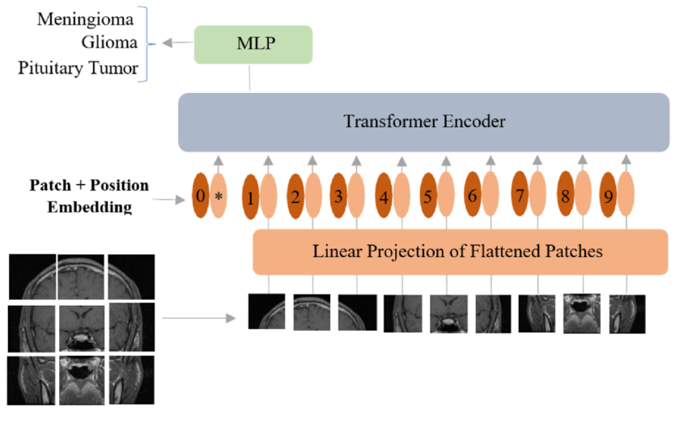
Vision Transformer (ViT)
The ViT is Used for image classification, detection, and segmentation, capturing local and global details. It’s also a backbone for multi-scale feature extraction in tasks like camouflaged object detection and image restoration.
ViT Process:
Patch Processing: Divides the image into patches, embeds each into a fixed-size vector.
Positional Encoding: Adds spatial information to patch embeddings.
Self-Attention Mechanism: Uses transformer layers to capture long-range dependencies.
Multi-Scale Feature Extraction: Processes patches at various resolutions to capture detailed features.
Notes:
The Vision Transformer (ViT) serves as the backbone of our model, enabling efficient multi-scale feature extraction. It excels in image classification, detection, and segmentation by capturing both local and global details, making it ideal for tasks like camouflaged object detection
ViT Process Overview:
Patch Processing: Images are divided into patches, each converted into a fixed-size vector for efficient processing.
Positional Encoding: Adds spatial information to help the model understand image layout and structure.
Self-Attention Mechanism: Captures long-range dependencies, identifying relationships across the entire image.
Multi-Scale Feature Extraction: Processes patches at different scales to extract detailed features for complex visual tasks.

Slide 9
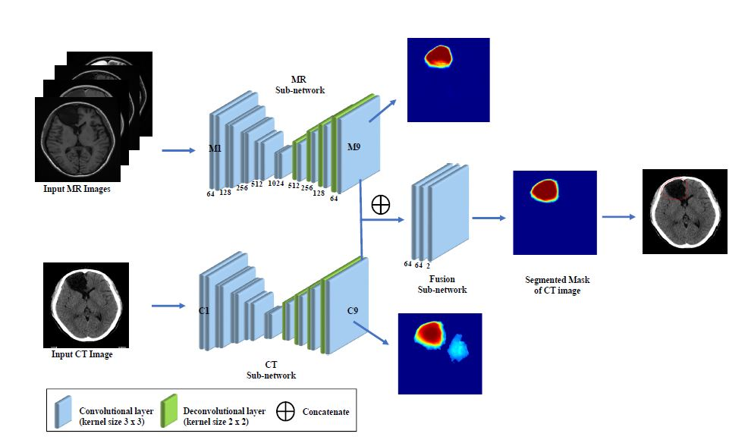
Feature Fusion (FF)
Multi-Scale Integration: The FF module merges features from different scales, capturing fine details and broader patterns, enriching the image representation.
Dynamic Weight Adjustment: During training, the module learns to prioritize key features with dynamic weights, often using attention mechanisms to improve focus.
Enhanced Image Processing: By combining multi-scale features, the FF module refines and improves image outputs, especially in tasks like restoration, segmentation and detection.
Notes:
The Feature Fusion (FF) module is critical to our model, integrating inputs from the Vision Transformer (ViT) to enhance performance.
Multi-Scale Integration: Combines features from different scales, capturing both fine details and broader patterns for a more robust image representation.

Slide 10
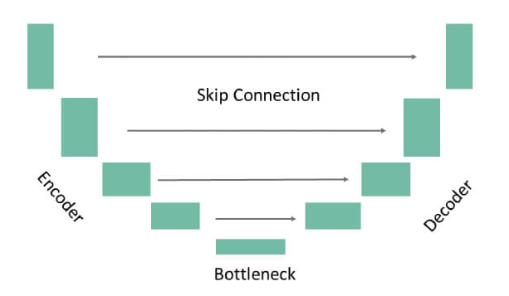
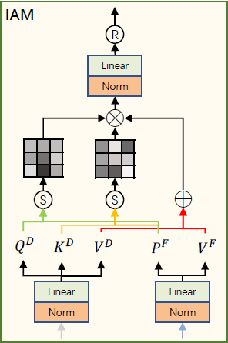
Denoising U-Net & IAM
Encoder: Downsamples the input, extracting multi-scale features while preserving essential information, reducing spatial dimensions progressively.
IAM in the Bottleneck: Integrated into U-Net's bottleneck, enhancing feature refinement by focusing on critical textures, guiding effective denoising.
Decoder: Upsamples encoded features to reconstruct the image, using transposed convolutions to restore resolution with a focus on detail.
Skip Connections: Link encoder and decoder layers, retaining high-resolution features to preserve fine details in the denoised output.
Notes:
In this slide, we’ll see the Denoising U-Net architecture with emphasis on the Injection Attention Module (IAM) and how it plays a crucial role in the reverse diffusion process.
We begin with the Encoder: Downsamples the input, extracting multi-scale features while preserving essential information, reducing spatial dimensions progressively.
Now, let's focus on the IAM in the Bottleneck: Integrated into U-Net's bottleneck, enhancing feature refinement by focusing on critical textures, guiding effective denoising.
After the IAM refines these features, the Decoder: Upsamples encoded features to reconstruct the image, using transposed convolutions to restore resolution with a focus on detail.
Skip Connections: Link encoder and decoder layers, retaining high-resolution features to preserve fine details in the denoised output.

Slide 11
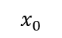
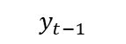

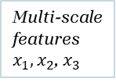
Model’s Process
Input Image
ViT – image processing
Multi-scale features$x_{1},x_{2}$, $x_{3}$
FF – feature extraction
$$x_{0}$$
$$x_{0}$$
Feature Map F
Noise addition
Denoising U-Net Encoder – Extract deepest features
IAM – guide diffusion process
Denoising U-Net Decoder – Produce Refined version
Detected Object/Anomaly
$$y_{t}$$
Feature Map D
Feature Map O
Gaussian/Salt & Pepper Noise
$$y_{t−1}$$
Notes:
This slide illustrates the overall flow of our model.
We start with the Input Image, which is first processed by the ViT (Vision Transformer) to extract multi-scale features. These features are then passed to the Feature Fusion (FF) module, which integrates and applies them Simultaneously. Noise is added to the input image to simulate degradation, producing a noisy image. The Denoising U-Net Encoder then extracts the deepest features from this noisy image. These features, along with the refined features from the FF module, are fed into the IAM (Injection Attention Module) to guide the diffusion process, focusing on reversing the noise.
Finally, the Denoising U-Net Decoder takes the output from the IAM to reconstruct the image, resulting in the Detected tumor Image.

Slide 12
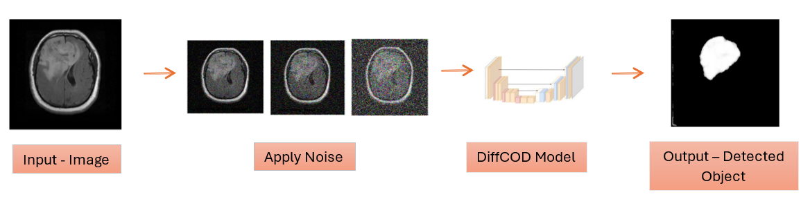
DIFFCOD – Train process
Input: Image from Brain MRI Dataset.
Adding Synthetic Noise: Simulating real-world conditions.
U-net Model Training: Iteratively mapping noisy to clean images.
Output: Ground Truth of detected anomaly.
Notes:
This slide outlines the training pipeline for DIFFCOD, focusing on detecting anomalies in brain MRI images. The process starts with input images from a brain MRI dataset. then Synthetic noise is then added to simulate real-world conditions, making the model robust to practical imaging challenges. The U-Net architecture plays a key role in training by iteratively mapping noisy images to their clean versions. Finally, the model outputs a segmentation mask, which represents the ground truth of the detected anomaly, such as a tumor or lesion. The visual pipeline below demonstrates this step-by-step flow, from the input image to the final output.

Slide 13
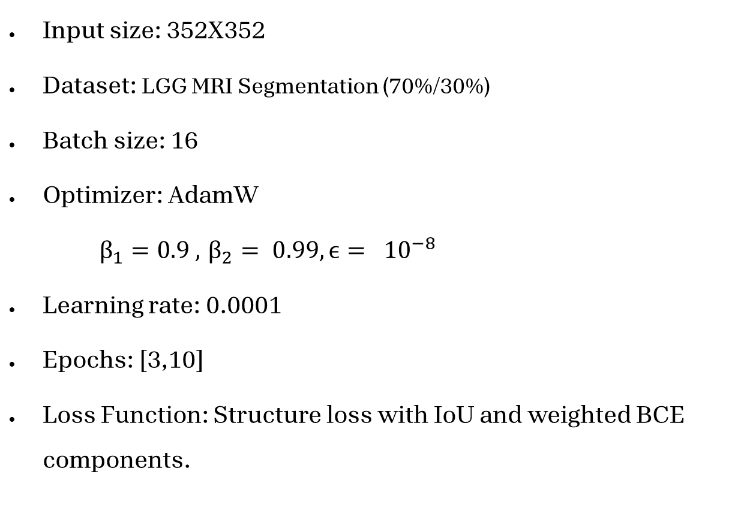
Hyperparameters
Input size: 352X352
Dataset: LGG MRI Segmentation (70%/30%)
Batch size: 16
Optimizer: AdamW
$β_{1}=0.9 , { β}_{2} = 0.99, ϵ= {10}^{−8}$
Learning rate: 0.0001
Epochs: [3,10]
Loss Function: Structure loss with IoU and weighted BCE components.
Notes:
In this model setup, the input size is 352x352, chosen to ensure a balance between computational efficiency and capturing sufficient detail for accurate tumor detection. The LGG MRI Segmentation dataset is used with a 70% training and 30% validation split, ensuring reliable model evaluation. A batch size of 16 is selected to optimize memory usage while maintaining stable gradient updates. The AdamW optimizer is employed for efficient weight updates, with β1=0.9, β2=0.99, and ϵ=${10}^{−8}$ for stability and better generalization. The learning rate is set to 0.0001 for steady and effective convergence. The model was trained and evaluated over multiple epochs, testing values from 3 to 10, to determine the optimal training duration for performance. The loss function combines structure loss with IoU and weighted Binary Cross-Entropy (BCE) components, ensuring the model accurately identifies tumor regions while handling complex spatial structures.

Slide 14
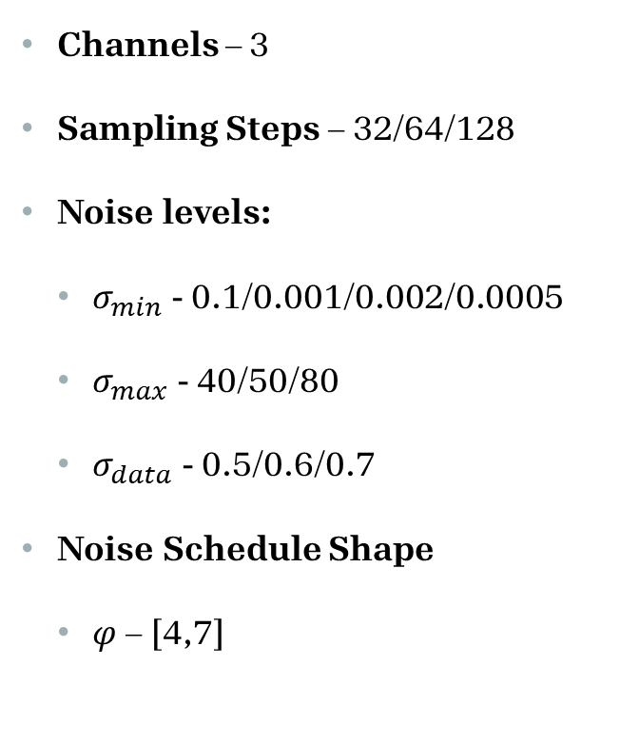
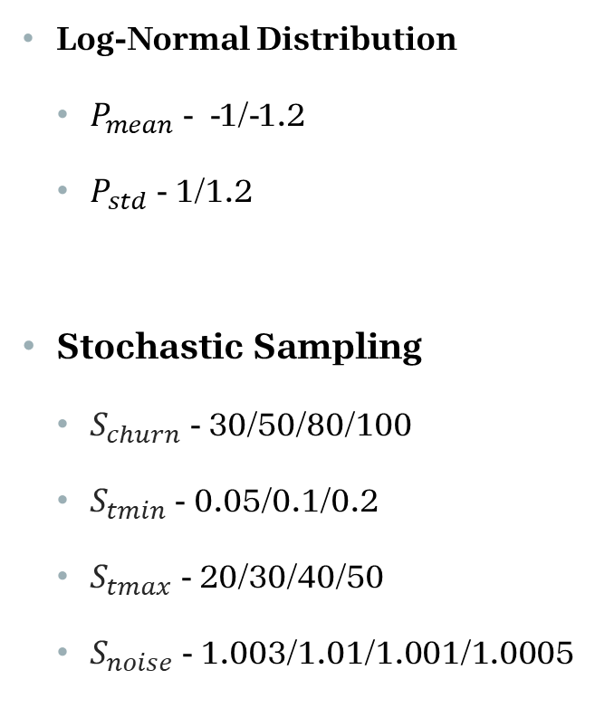
Noise parameters
Channels – 3
Sampling Steps – 32/64/128
Noise levels:
$σ_{min}$ - 0.1/0.001/0.002/0.0005
$σ_{max}$ - 40/50/80
$σ_{data}$ - 0.5/0.6/0.7
Noise Schedule Shape
$φ$– [4,7]
Log-Normal Distribution
$P_{mean}$ - -1/-1.2
$P_{std}$ - 1/1.2
Stochastic Sampling
$S_{churn}$ - 30/50/80/100
$S_{tmin}$- 0.05/0.1/0.2
$S_{tmax}$ - 20/30/40/50
$S_{noise}$ - 1.003/1.01/1.001/1.0005
Notes:
The noise parameters were tested with varying values to evaluate how well the model adapts to different noise types—Gaussian and salt-and-pepper—and their respective degradation scenarios. This systematic testing ensures the model is robust and capable of effective tumor detection across diverse noise conditions in brain MRI images.
Channels (3): This specifies the number of input channels. Testing this ensures that the model handles the expected RGB or grayscale input data effectively.
Sampling Steps (32/64/128): Higher sampling steps allow more detailed refinement during the reverse diffusion process. Testing multiple steps ensures the model can handle varying levels of degradation, balancing computational cost and performance.
Noise Levels:
σmin: Represents the starting point of minimal noise. Testing ensures that the model remains sensitive to small variations critical for preserving diagnostic features in MRI images.
σmax​: Simulates severe degradation levels, particularly for Gaussian noise, pushing the model to perform under extreme noise conditions.
σdata: Adjusting this helps optimize the balance between the model's ability to preserve fine details and suppress noise.
Noise Schedule Shape (φ): Influences the rate of noise addition and removal, enabling the model to focus on challenging regions where noise disrupts finer image details.
Log-Normal Distribution:
Pmean and Pstd​: Adjust the noise distribution to represent real-world variations. Testing different distributions ensures the model handles both structured (e.g., Gaussian) and unstructured (e.g., salt-and-pepper) noise effectively.
Stochastic Sampling:
Schurn​,Stmin​,Stmax​,Snoise​: These parameters introduce randomness into the sampling process, enhancing the model's ability to generalize across diverse noise patterns. Testing various settings ensures the model does not overfit to specific noise levels or distributions.
By systematically adjusting these parameters, the model can be optimized for robust tumor detection, even under challenging noise conditions, ensuring accurate segmentation and localization in MRI datasets. This process fine-tunes the model for handling Gaussian noise, which affects the entire image, and salt-and-pepper noise, which introduces abrupt, pixel-level artifacts.

Slide 15
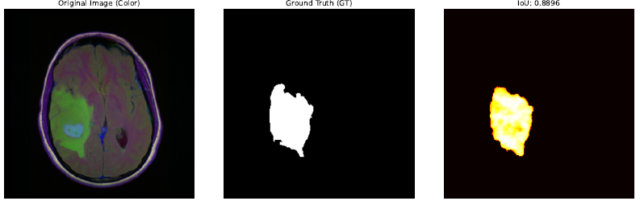
Result Examples – GAUSSIAN noise
להוסיף מלל
Notes:
This slide presents examples of the model's performance under Gaussian noise conditions. The original images (left) are the clean MRI scans, while the Ground Truth (GT) (middle) represents the manually annotated tumor regions used for evaluation. The predicted results (right) show the model's segmentation outputs, with IoU scores that reflect strong alignment with the ground truth.
It is important to note that these examples showcase results from the higher end of the performance spectrum. While the full set of results, includes a range of metric values, these examples were selected to highlight the model's capability to achieve accurate tumor segmentation under optimal conditions. This demonstrates the model's potential for robust tumor detection in MRI scans, even in the context of noise handling during training and testing.

Slide 16
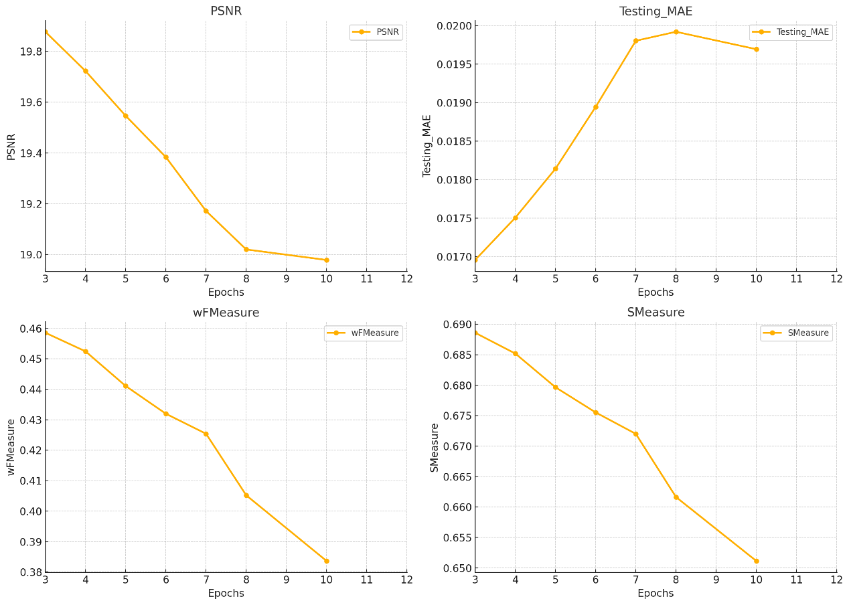
Metrics – GAUSSIAN noise
PSNR (Peak Signal-to-Noise Ratio) indicates image quality, higher values are better
MAE (Mean Absolute Error) measures prediction error, lower values are better
Notes:
This slide illustrates the performance metrics for the model under Gaussian noise conditions, as measured by PSNR (Peak Signal-to-Noise Ratio) and Testing MAE (Mean Absolute Error) across different numbers of training epochs.
PSNR (left chart): The PSNR values show a gradual decrease as the number of epochs increases. This could indicate that while the model continues to fine-tune its predictions, the improvement in noise removal or restoration quality plateaus, and overfitting to the noise might occur. Higher PSNR values, observed at earlier epochs, suggest better image restoration quality in terms of similarity to the original image.
Testing MAE (right chart): The Testing MAE shows an initial increase as the number of epochs grows, peaking around 7-8 epochs, before slightly decreasing. This trend might suggest that the model struggles to generalize well to unseen noisy data as it learns more specific features from the training data, further supporting potential overfitting at higher epochs.

Slide 17
Metrics – GAUSSIAN noise
wFMeasure shows how well the model balances precision and recall, higher is better
SMeasure assesses structural similarity, higher values indicate better performance
Notes:
This slide illustrates the model's performance under Gaussian noise conditions as measured by two key segmentation metrics: wFMeasure (Weighted F-measure) and SMeasure (Structure Measure) across different numbers of epochs.
wFMeasure (left chart): This metric combines precision and recall with weighting to account for class imbalances, particularly in tumor regions versus background. The steady decline in wFMeasure as the number of epochs increases suggests potential overfitting to training data, where the model becomes less effective in generalizing to unseen noisy inputs. The peak performance appears earlier in the epoch range, around 4-6 epochs.
SMeasure (right chart): SMeasure balances region-based and object-based evaluation for segmentation quality. The decreasing trend indicates that the structural integrity of the segmentation degrades with additional training, potentially due to overfitting. The highest SMeasure values are observed in the early epochs (3-5), indicating better segmentation quality and structural consistency during this phase.
These results reinforce the observation that optimal training for Gaussian noise lies in the lower epoch range (around 3-6 epochs). Beyond this point, the model may lose its ability to generalize and maintain segmentation accuracy, highlighting the importance of careful epoch selection for robust performance. This trend also aligns with earlier metrics, such as PSNR and MAE, further supporting the need for controlled training duration.

Slide 18
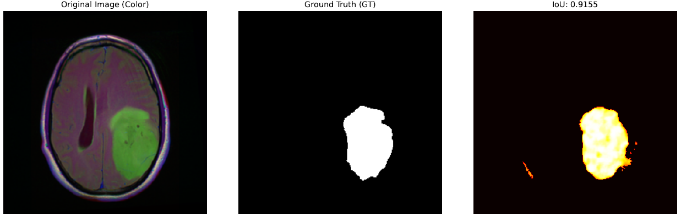
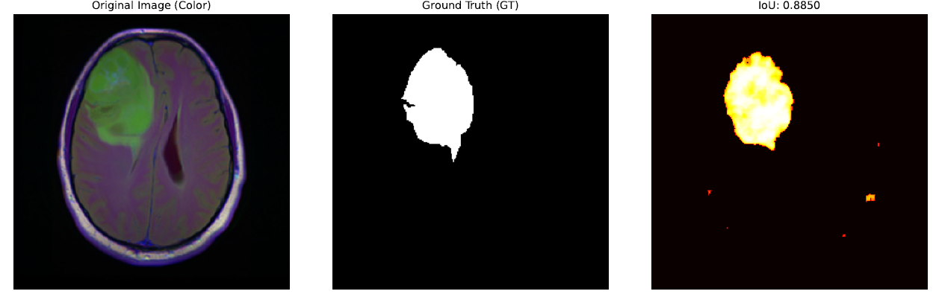
Result Examples – Salt & pepper noise
Notes:
This slide shows result examples for salt and pepper noise. While the model achieves overall fine results, it struggles with this type of noise, as evident in the prediction masks where 'not clean' areas and repetitive shapes are present. These artifacts highlight the challenges posed by the irregular and sparse nature of salt and pepper noise, which makes it harder for the model to accurately reconstruct the anomalies. Despite this, the model demonstrates reasonable performance, though less stable compared to its results with Gaussian noise.

Slide 19
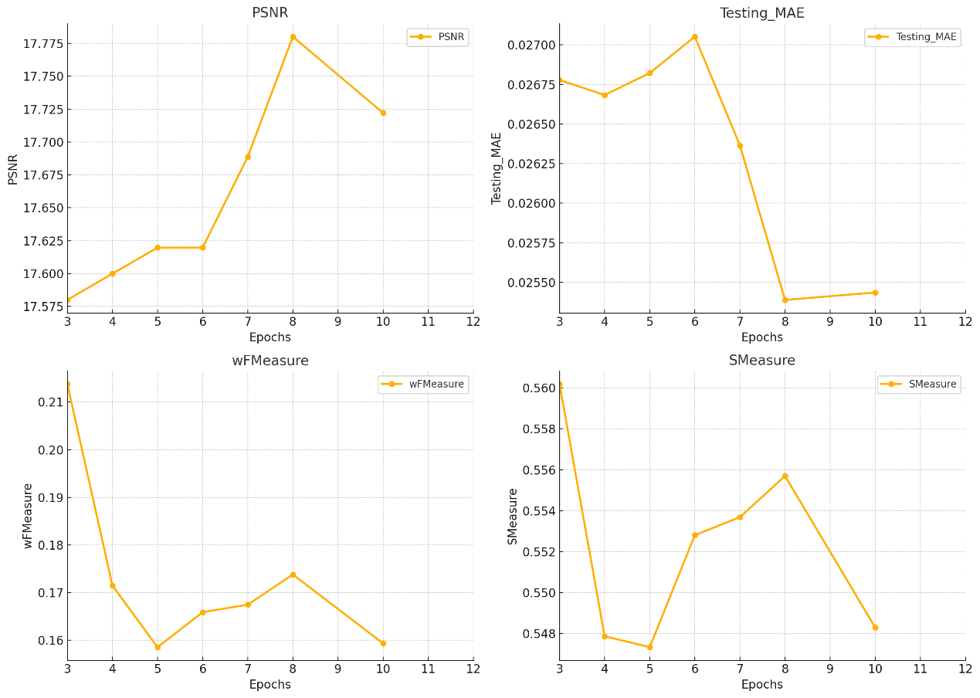
Metrics – Salt & pepper noise
PSNR (Peak Signal-to-Noise Ratio) indicates image quality, higher values are better
MAE (Mean Absolute Error) measures prediction error, lower values are better
Notes:
This slide presents the PSNR and MAE metrics for salt and pepper noise over training epochs. While the model shows improvement initially, there is noticeable instability in performance compared to Gaussian noise. The PSNR peaks at epoch 8 but drops afterward, indicating fluctuations in reconstruction quality. Similarly, the MAE shows inconsistent trends, further highlighting the challenges the model faces with the irregular nature of salt and pepper noise. This instability contrasts with the more consistent results observed under Gaussian noise conditions.

Slide 20
Metrics – Salt & pepper noise
wFMeasure shows how well the model balances precision and recall, higher is better
SMeasure assesses structural similarity, higher values indicate better performance
Notes:
Continuing from the previous slide, the weighted F-measure (wFMeasure) and structural measure (SMeasure) further illustrate the instability caused by salt and pepper noise. Both metrics display significant fluctuations across epochs, with noticeable drops and inconsistent recovery patterns. These trends indicate that the model struggles to maintain consistent performance in identifying and reconstructing anomalies under this type of noise. Compared to Gaussian noise, the irregular nature of salt and pepper noise introduces more variability, challenging the model's ability to achieve stable structural and feature-based predictions.

Slide 21
Testing Results – Gaussian Noise
Original Parameters
Psnr | Testing MAE | wFMeasure | Smeasure | Training MAE | Training loss | Epochs
17.5392 | 0.0269 | 0.4700 | 0.6804 | 0.0269 | 1.3199 | 3
19.4712 | 0.0184 | 0.4011 | 0.6590 | 0.0344 | 1.3392 | 4
18.1817 | 0.0200 | 0.4425 | 0.6774 | 0.1596 | 1.2955 | 5
19.2103 | 0.0201 | 0.3762 | 0.6531 | 0.0784 | 1.3182 | 6
17.7573 | 0.0257 | 0.1519 | 0.5459 | 0.4589 | 1.4294 | 7
17.3659 | 0.0244 | 0.1380 | 0.5346 | 0.2229 | 1.3312 | 10
 | 0.0272 | 0.1010 | 0.5221 | 0.1149 | 1.1990 | 20
 | 0.0293 | 0.0078 | 0.0000 | 0.1211 | 1.0994 | 30
New Parameters 1
Psnr | Testing MAE | wFMeasure | Smeasure | Training MAE | Training loss | Epochs
17.4871 | 0.0271 | 0.0979 | 0.5213 | 0.0527 | 1.3235 | 3
19.6559 | 0.0176 | 0.5019 | 0.7096 | 0.0293 | 1.3215 | 4
17.2734 | 0.0280 | 0.0685 | 0.5089 | 0.2245 | 1.3114 | 5
19.5546 | 0.0177 | 0.4157 | 0.6654 | 0.1301 | 1.3167 | 6
17.1912 | 0.0290 | 0.0285 | 0.4945 | 0.3206 | 1.3901 | 7
18.8778 | 0.0199 | 0.3565 | 0.6367 | 0.3587 | 1.3421 | 10
New Parameters 2
Psnr | Testing MAE | wFMeasure | Smeasure | Training MAE | Training loss | Epochs
17.7457 | 0.0262 | 0.4713 | 0.6883 | 0.0269 | 1.3099 | 3
18.9374 | 0.0198 | 0.3594 | 0.6387 | 0.0423 | 1.3469 | 4
19.6575 | 0.0186 | 0.4697 | 0.6938 | 0.1298 | 1.3142 | 5
18.9002 | 0.0206 | 0.3263 | 0.6248 | 0.1221 | 1.2998 | 6
18.4981 | 0.0244 | 0.4350 | 0.6753 | 0.1693 | 1.3370 | 7
18.1449 | 0.0238 | 0.2272 | 0.5750 | 0.2484 | 1.3122 | 10
17.1435 | 0.0292 | 0.0142 | 0.4894 | 0.1361 | 1.1459 | 30
New Parameters 4
Psnr | Testing MAE | wFMeasure | Smeasure | Training MAE | Training loss | Epochs
17.1627 | 0.0291 | 0.0195 | 0.4915 | 0.1079 | 1.3126 | 3
20.3634 | 0.0153 | 0.8651 | 0.7185 | 0.0397 | 1.3207 | 4
19.7104 | 0.0181 | 0.6435 | 0.6693 | 0.0376 | 1.3351 | 4
18.0228 | 0.0237 | 0.3329 | 0.5832 | 0.2398 | 1.3317 | 5
18.0782 | 0.0235 | 0.3306 | 0.5802 | 0.5193 | 1.3399 | 5
18.1413 | 0.0238 | 0.2962 | 0.5729 | 0.2959 | 1.3473 | 6
17.9259 | 0.0243 | 0.2674 | 0.5617 | 0.2598 | 1.4088 | 7
19.8022 | 0.0169 | 0.7838 | 0.6968 | 0.5410 | 1.3620 | 8
17.4827 | 0.0272 | 0.1215 | 0.5214 | 0.2016 | 1.3218 | 10
Notes:
For New Values 1, the sampling steps were increased to 64, enabling finer refinement while balancing computational cost. Noise levels were adjusted by reducing σ_min and σ_max to focus on small noise variations and moderate degradation, with a slight increase in σ_data to preserve details. Stochastic sampling parameters were reduced to minimize randomness, improving stability for structured noise scenarios.
For New Values 2, the sampling steps were increased to 128, allowing highly detailed refinement but at a higher computational cost. Noise levels were further adjusted by lowering σ_min and σ_max to emphasize handling small variations and moderate noise, with σ_data increased to enhance detail preservation. Stochastic sampling adjustments focused on less randomness to improve robustness against abrupt noise patterns.
For New Values 4, the sampling steps were increased to 64, providing a balance between refinement and computational cost. Noise levels such as σ_min and σ_max were kept moderate, focusing on handling both fine noise and degradation, with σ_data slightly lowered to adjust detail preservation. Stochastic sampling parameters like S_churn and S_noise were increased to test the model's performance under more diverse and random noise patterns, enhancing its generalization capability.

Slide 22
Testing Results – Salt & pepper Noise
Original model parameters
Psnr | Testing MAE | wFMeasure | Smeasure | Training MAE | Training loss | Epochs
19.9869 | 0.0165 | 0.4617 | 0.6907 | 0.0169 | 1.3551 | 3
19.9627 | 0.0174 | 0.4660 | 0.6893 | 0.0230 | 1.3137 | 4
19.3779 | 0.0189 | 0.4940 | 0.7039 | 0.1530 | 1.3162 | 5
20.2283 | 0.0159 | 0.4815 | 0.7004 | 0.0603 | 1.2894 | 6
17.4719 | 0.0272 | 0.0937 | 0.5198 | 0.1437 | 1.3516 | 7
18.8521 | 0.0225 | 0.4549 | 0.6852 | 0.1729 | 1.3087 | 8
17.6670 | 0.0261 | 0.1447 | 0.5382 | 0.3205 | 1.3093 | 10
New Parameters 1
Psnr | Testing MAE | wFMeasure | Smeasure | Training MAE | Training loss | Epochs
17.2236 | 0.0287 | 0.0376 | 0.4978 | 0.0436 | 1.3165 | 3
17.4180 | 0.0275 | 0.0821 | 0.5152 | 0.0292 | 1.3911 | 4
18.0819 | 0.0240 | 0.2114 | 0.5684 | 0.2303 | 1.3137 | 5
19.9207 | 0.0162 | 0.4608 | 0.6900 | 0.1246 | 1.3244 | 6
17.4760 | 0.0271 | 0.0999 | 0.5209 | 0.3983 | 1.3991 | 7
18.1623 | 0.0233 | 0.2552 | 0.5928 | 0.5248 | 1.3542 | 8
19.0830 | 0.0193 | 0.3807 | 0.6517 | 0.3524 | 1.3467 | 10
18.0770 | 0.0237 | 0.2162 | 0.5712 | 0.1714 | 1.2454 | 15
New Parameters 2
Psnr | Testing MAE | wFMeasure | Smeasure | Training MAE | Training loss | Epochs
17.1092 | 0.0294 | 0.0008 | 0.4855 | 0.1058 | 1.3162 | 3
17.7331 | 0.0259 | 0.1505 | 0.5422 | 0.0549 | 1.3472 | 4
17.6639 | 0.0263 | 0.1368 | 0.5372 | 0.1838 | 1.3084 | 5
17.1625 | 0.0291 | 0.0188 | 0.4913 | 0.1164 | 1.2956 | 6
17.2342 | 0.0288 | 0.0376 | 0.4982 | 0.4324 | 1.3403 | 10
New Parameters 3
Psnr | Testing MAE | wFMeasure | Smeasure | Training MAE | Training loss | Epochs
18.3350 | 0.0228 | 0.2514 | 0.5864 | 0.0234 | 1.3112 | 3
19.8358 | 0.0172 | 0.4505 | 0.6853 | 0.0528 | 1.3511 | 4
19.7555 | 0.0174 | 0.4614 | 0.6899 | 0.1952 | 1.3313 | 5
18.0569 | 0.0270 | 0.4216 | 0.6672 | 0.0550 | 1.3120 | 6
19.6119 | 0.0180 | 0.4705 | 0.6960 | 0.3736 | 1.4147 | 7
19.0506 | 0.0197 | 0.3494 | 0.6330 | 0.1365 | 1.2865 | 8
17.2995 | 0.0283 | 0.0559 | 0.5044 | 0.2726 | 1.3421 | 10
Notes:
For New Values 3, the sampling steps remained at 32 for baseline comparison, while σ_min was increased, and σ_data was further adjusted to balance detail preservation and noise suppression. Stochastic sampling values like S_churn and S_tmax were decreased, allowing the model to generalize better across moderate noise conditions while maintaining stability.

Slide 23
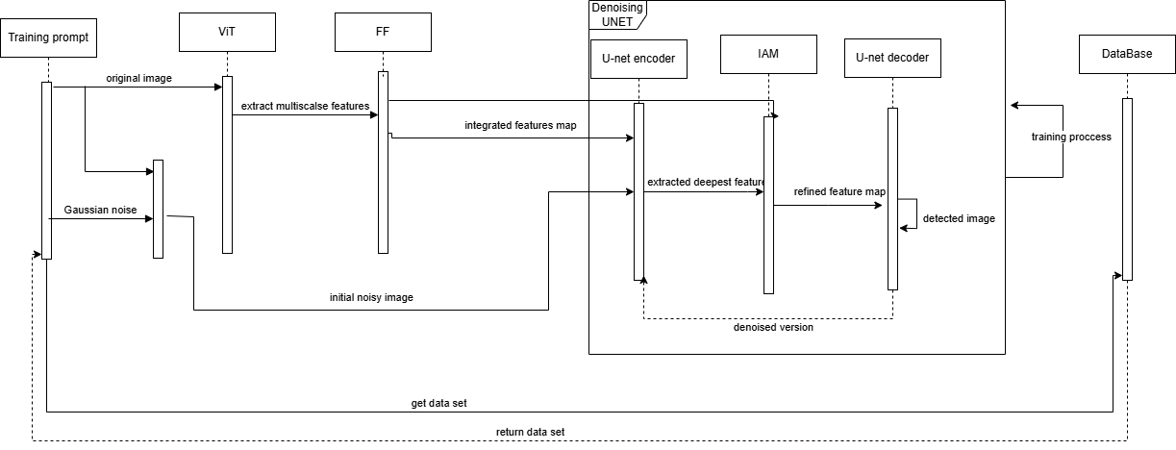
Sequence

Slide 24
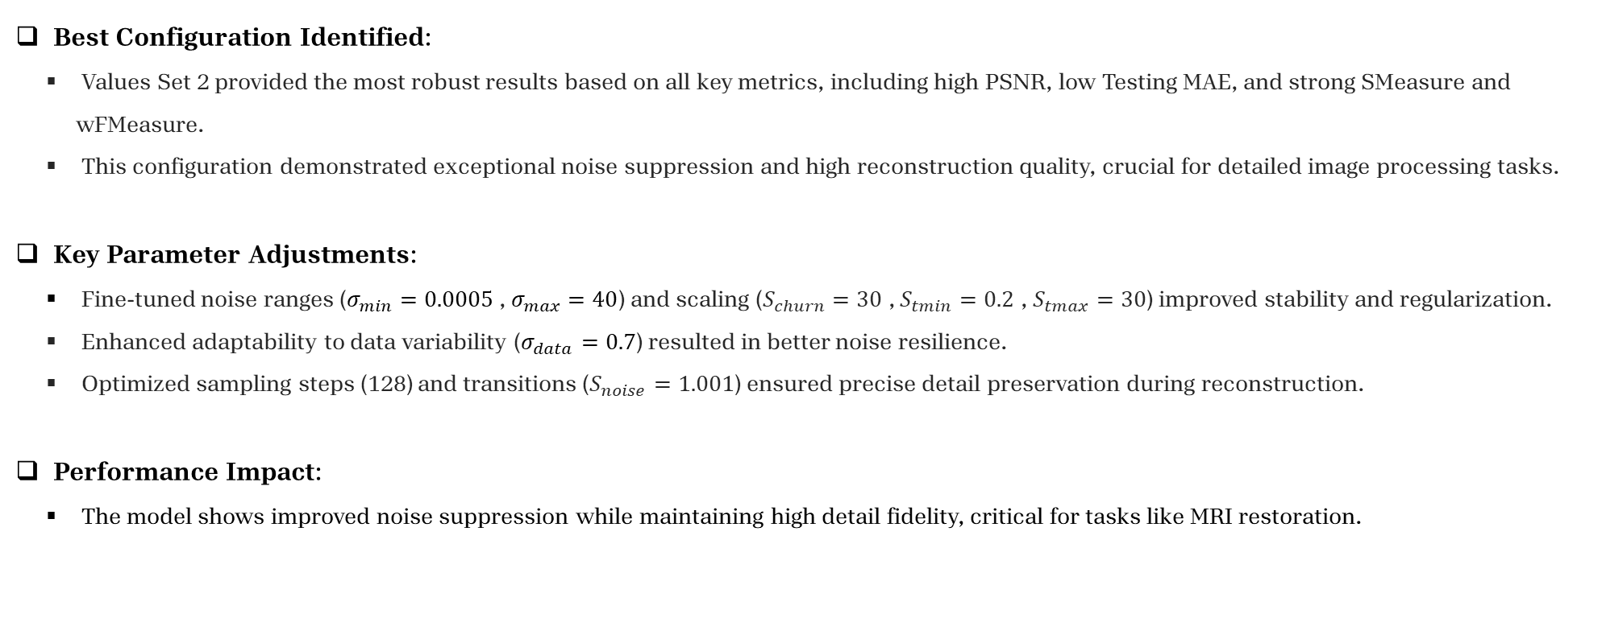
conclusion
Best Configuration Identified:
Values Set 2 provided the most robust results based on all key metrics, including high PSNR, low Testing MAE, and strong SMeasure and wFMeasure.
This configuration demonstrated exceptional noise suppression and high reconstruction quality, crucial for detailed image processing tasks.
Key Parameter Adjustments:
Fine-tuned noise ranges ($σ_{min}=0.0005$ , $σ_{max}=40$) and scaling ($S_{churn}=30$ , $S_{tmin}=0.2$ , $S_{tmax}=30$) improved stability and regularization.
Enhanced adaptability to data variability ($σ_{data}=0.7$) resulted in better noise resilience.
Optimized sampling steps (128) and transitions ($S_{noise}=1.001$) ensured precise detail preservation during reconstruction.
Performance Impact:
The model shows improved noise suppression while maintaining high detail fidelity, critical for tasks like MRI restoration.

Slide 25
Thank you for listening

